Slide 1
Introduction to Computing for Data Analysis
Does my (numerical) program compute the right answer?
Richard Vuduc, Ph.D.
Associate Professor
School of Computational Science and Engineering
Computing a sum, part 1: Correctness in exact arithmetic
Notes:
Okay, kiddos, it’s now time to put our analysis theory into practice with an example.
I want you to look specifically at the problem of summing a list of numbers, in two parts.
In this first part, let’s ignore the possibility of floating-point rounding errors to build your intuition for what a correctness analysis looks like.

Slide 2
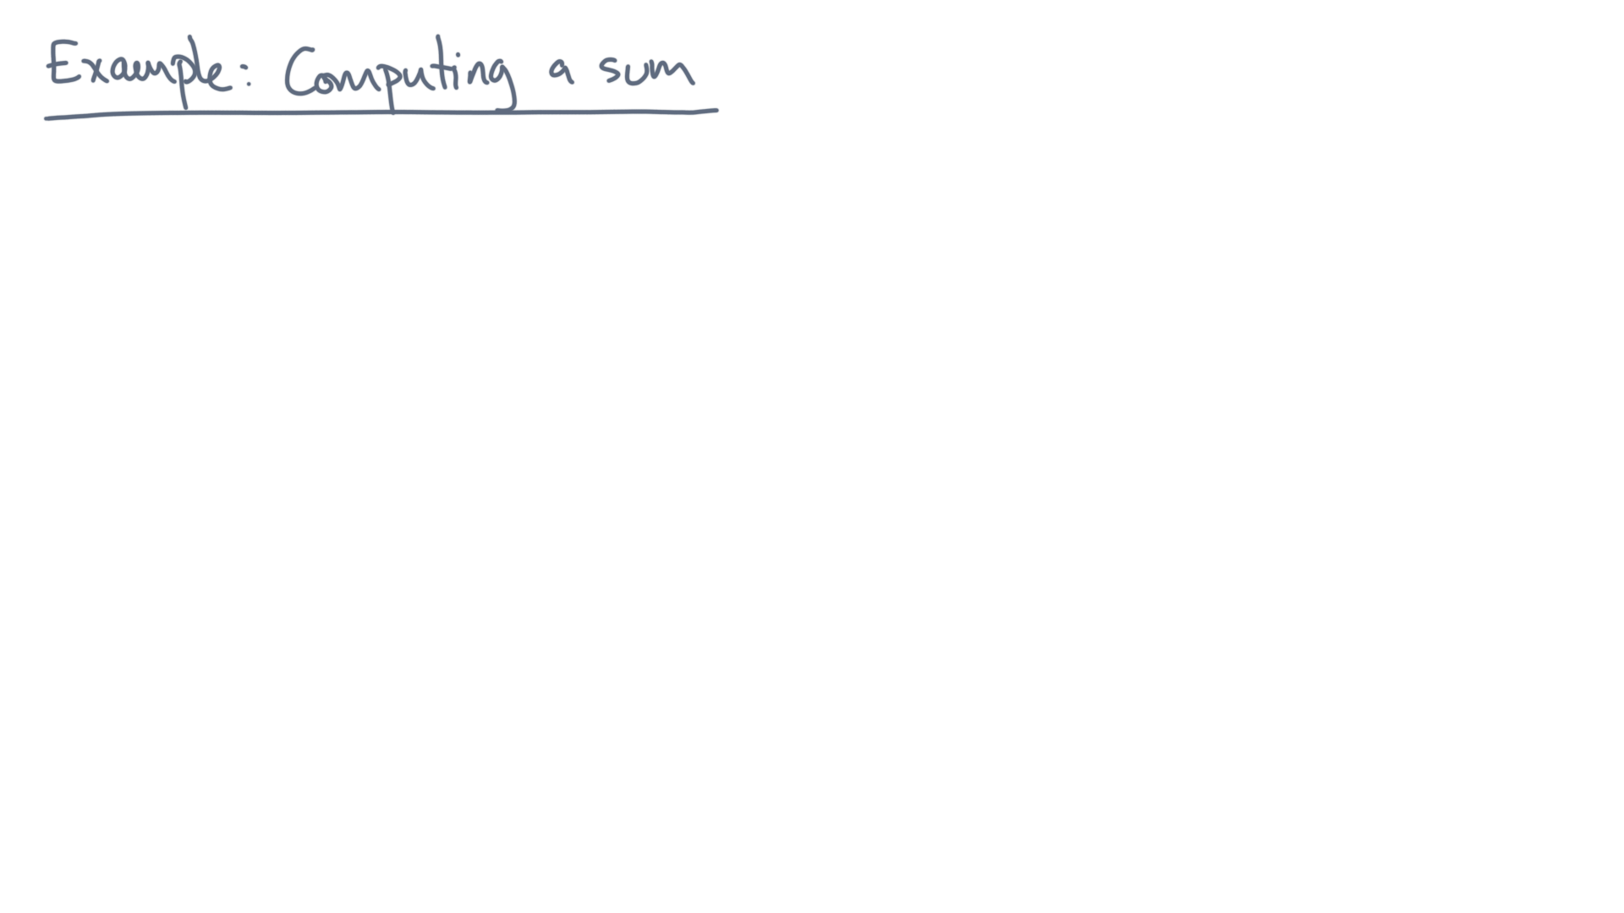
Notes:
Let’s start by formalizing the problem.

Slide 3
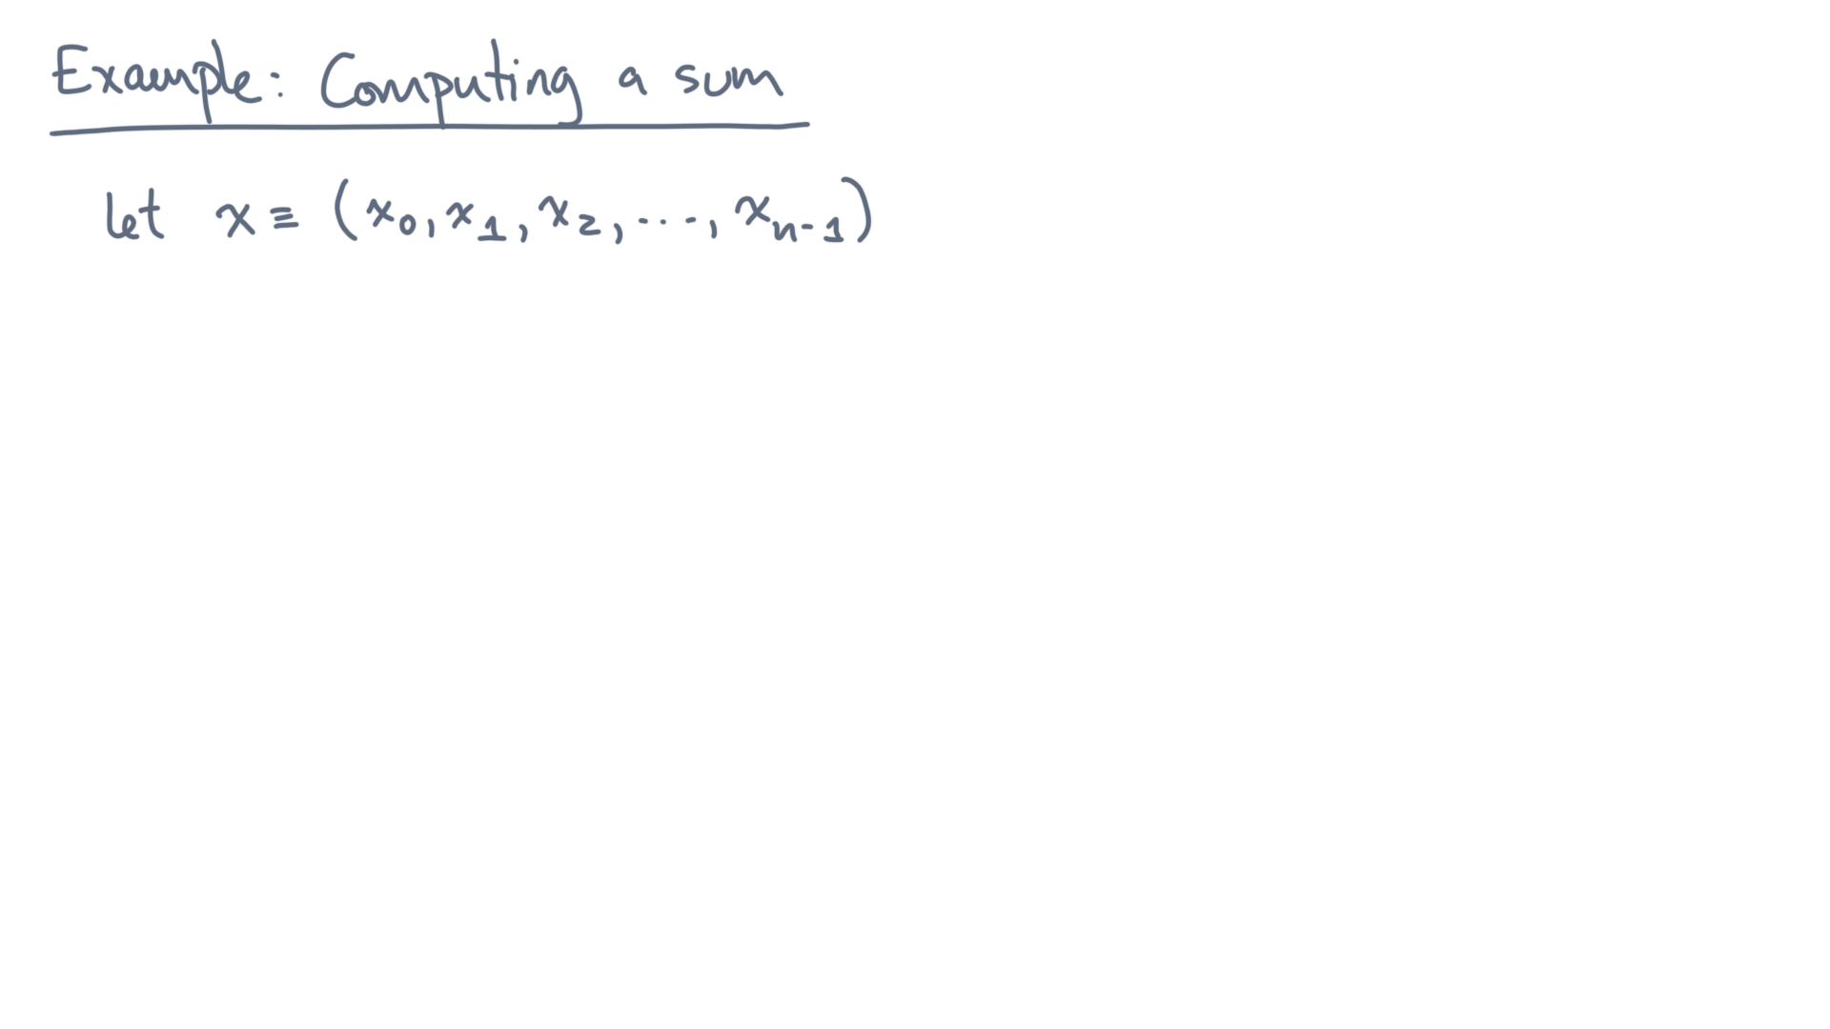
Notes:
Let x be a collection of n input values, numbered from 0 to n minus 1.

Slide 4
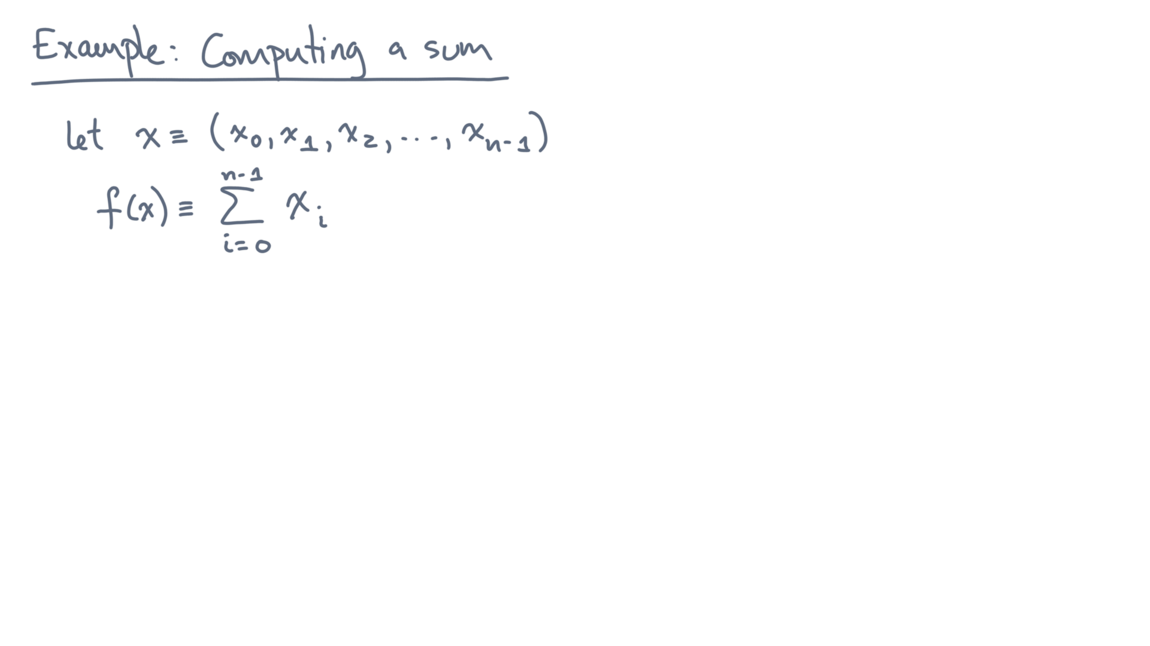
Notes:
The function you want to compute, f(x), is the sum of all these elements.

Slide 5
def alg_sum(x):
s = 0.0
for x_i in x:
s += x_i
return s
Notes:
Here is an algorithm to compute the sum, implemented as a Python function named “alg_sum.”

Slide 6
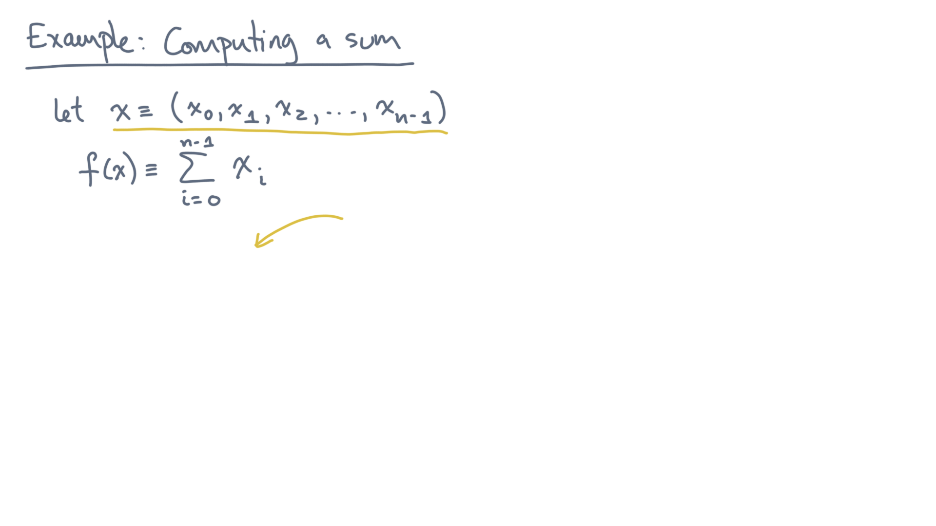
def alg_sum(x):
s = 0.0
for x_i in x:
s += x_i
return s
Notes:
Its argument “x” is the collection of input values.

Slide 7
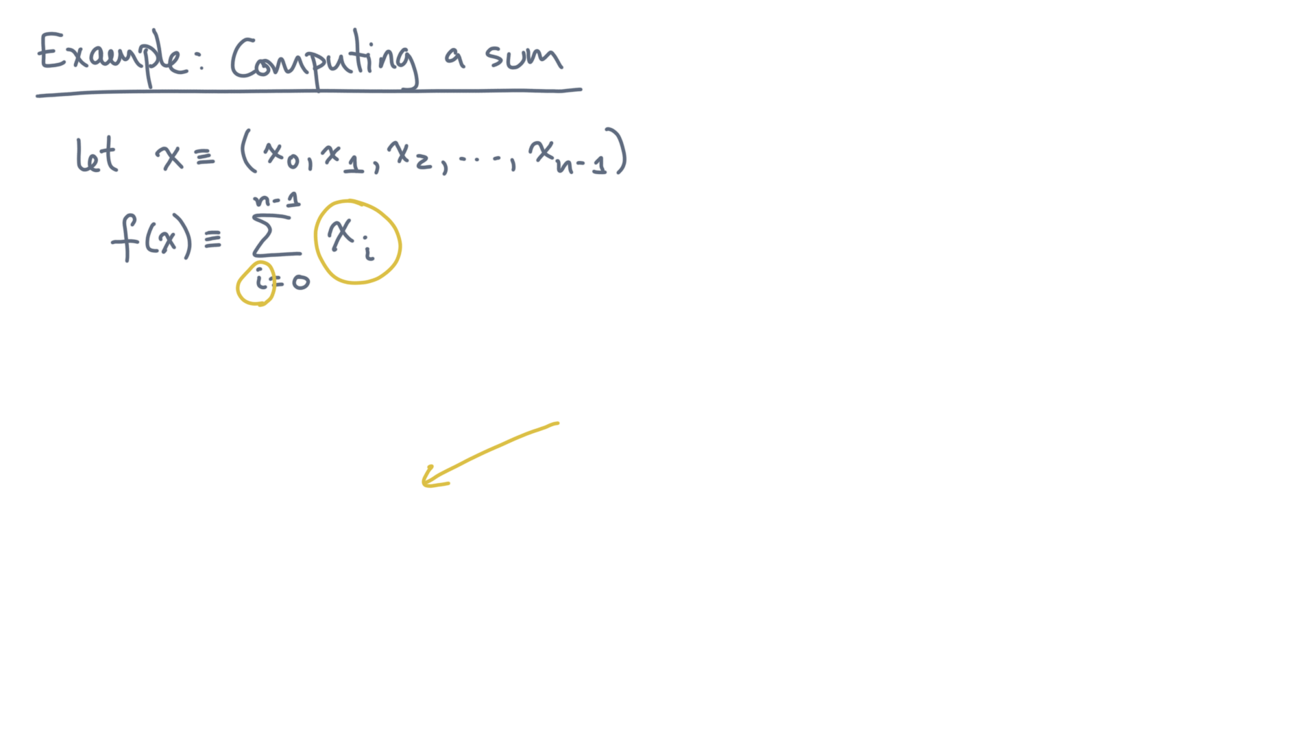
def alg_sum(x):
s = 0.0
for x_i in x:
s += x_i
return s
Notes:
Let’s assume this collection is iterable, meaning you can loop over its elements.

Slide 8
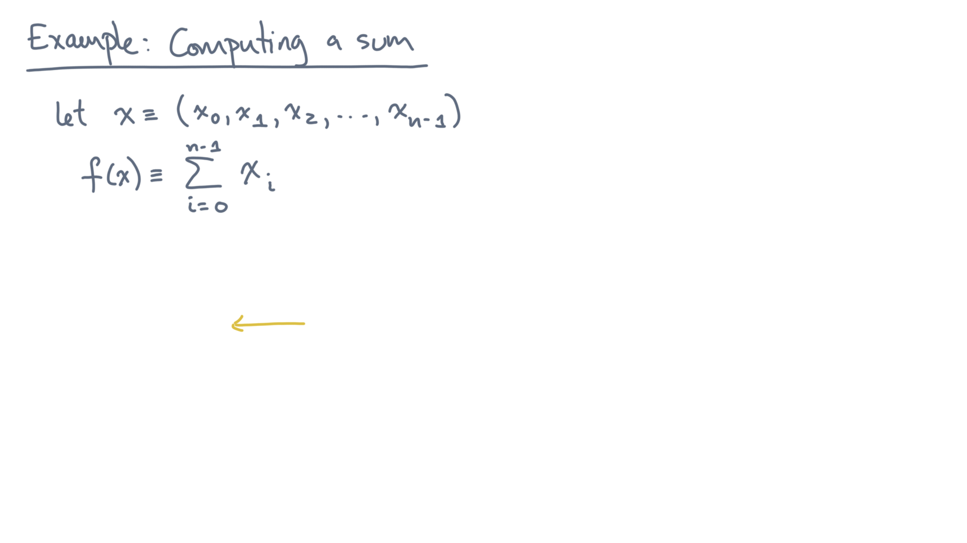
def alg_sum(x):
s = 0.0
for x_i in x:
s += x_i
return s
Notes:
The algorithm uses a temporary scalar variable, “s”, to hold a running sum.
It initializes it to 0 in the first line. Notice that the initializer is declared to be a floating-point value, so let’s assume we might expect the input “x” to contain floating-point values, too.

Slide 9
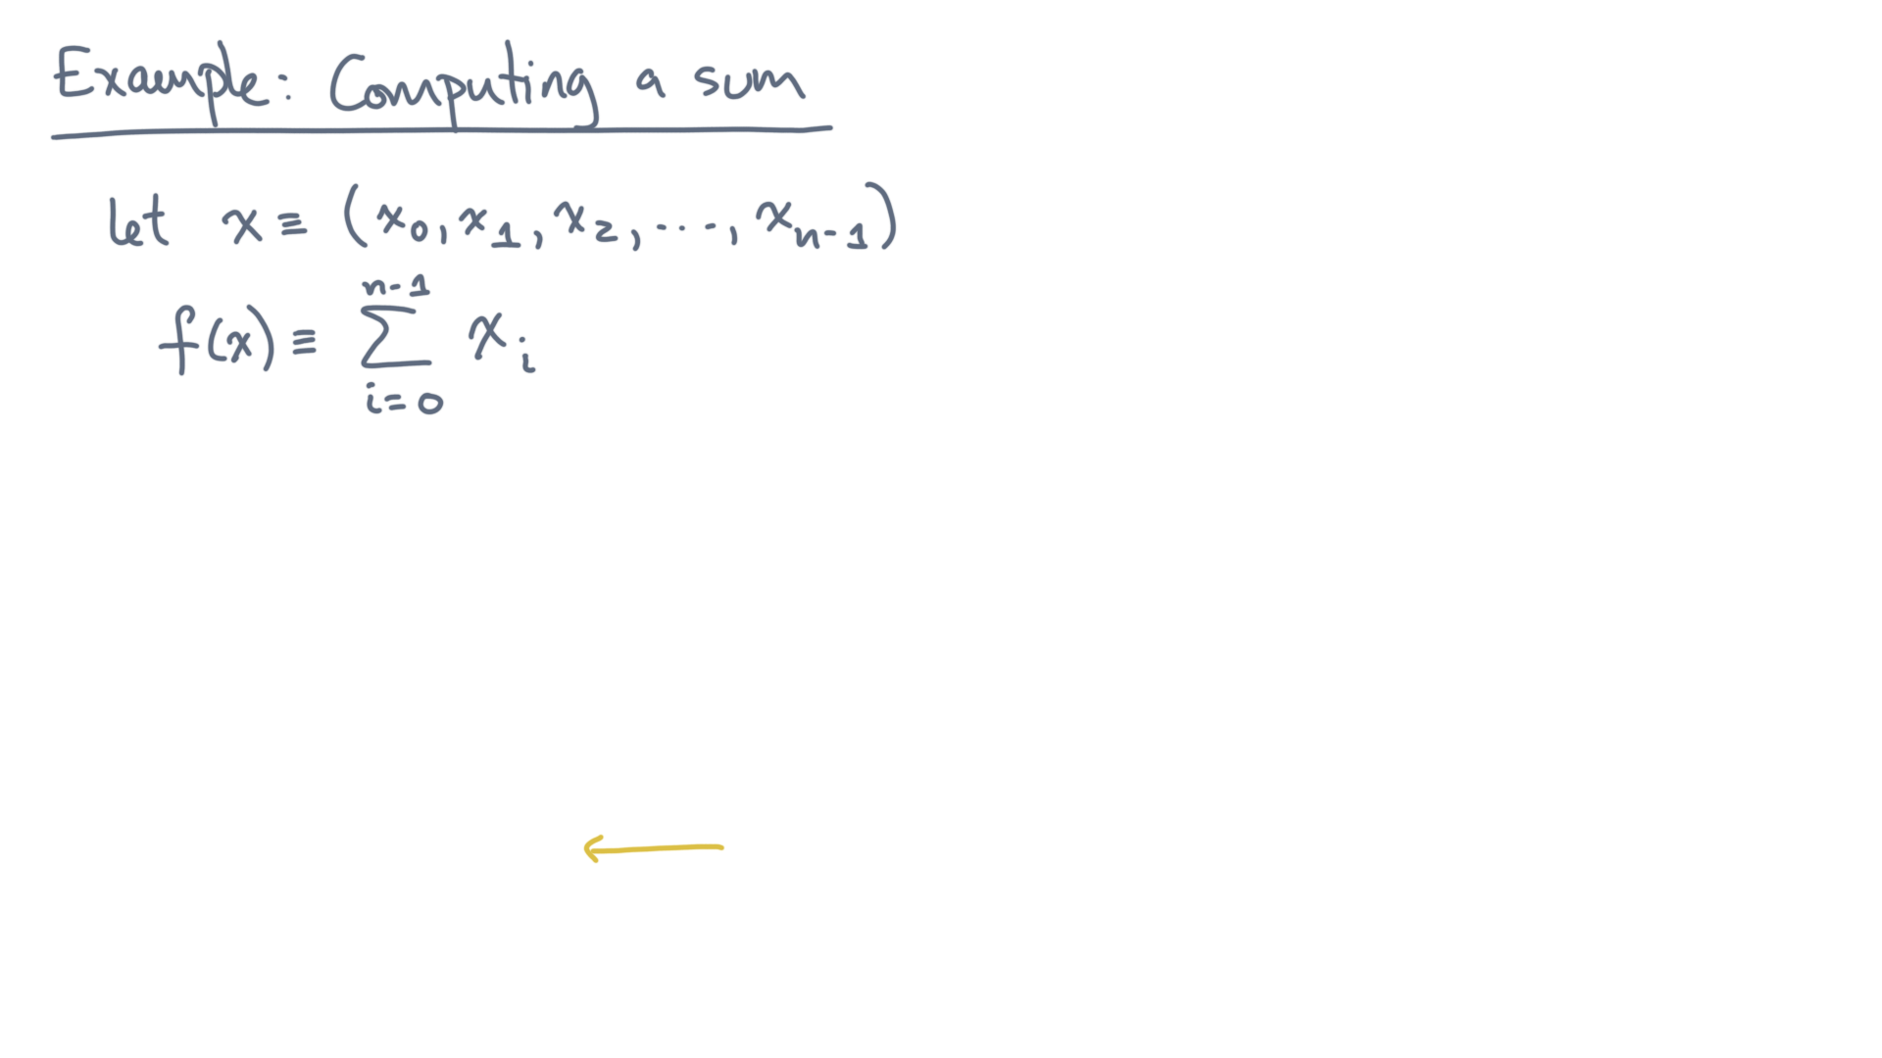
def alg_sum(x):
s = 0.0
for x_i in x:
s += x_i
return s
Notes:
Then, in the body of the for loop, it accumulates each element.

Slide 10
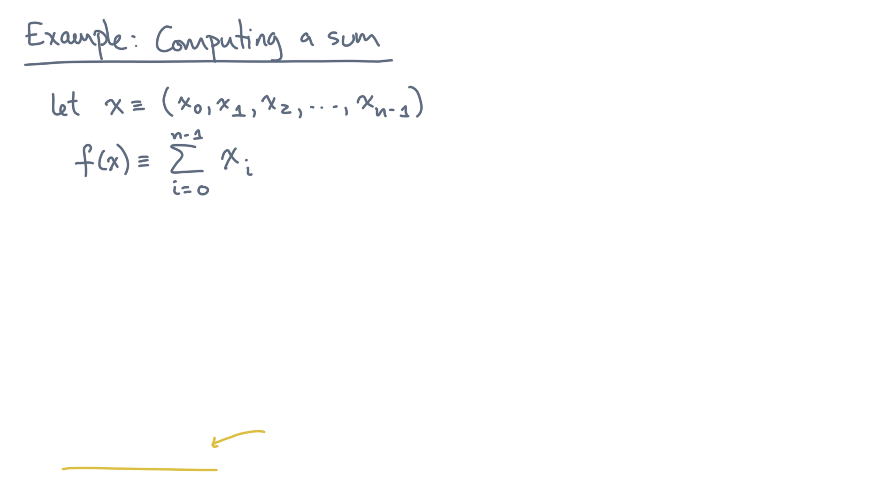
def alg_sum(x):
s = 0.0
for x_i in x:
s += x_i
return s
Notes:
It ends by returning this value “s”.

Slide 11
def alg_sum(x):
s = 0.0
for x_i in x:
s += x_i
return s
Notes:
Now I know what you’re thinking: isn’t it obvious that this program is correct?
Maybe, but I want you to wear your computer scientist’s hat for a moment and ask yourself, how would I *prove* that it’s correct?
After all, the code involves floating-point arithmetic, which is approximate, so how can you be sure?

Slide 12
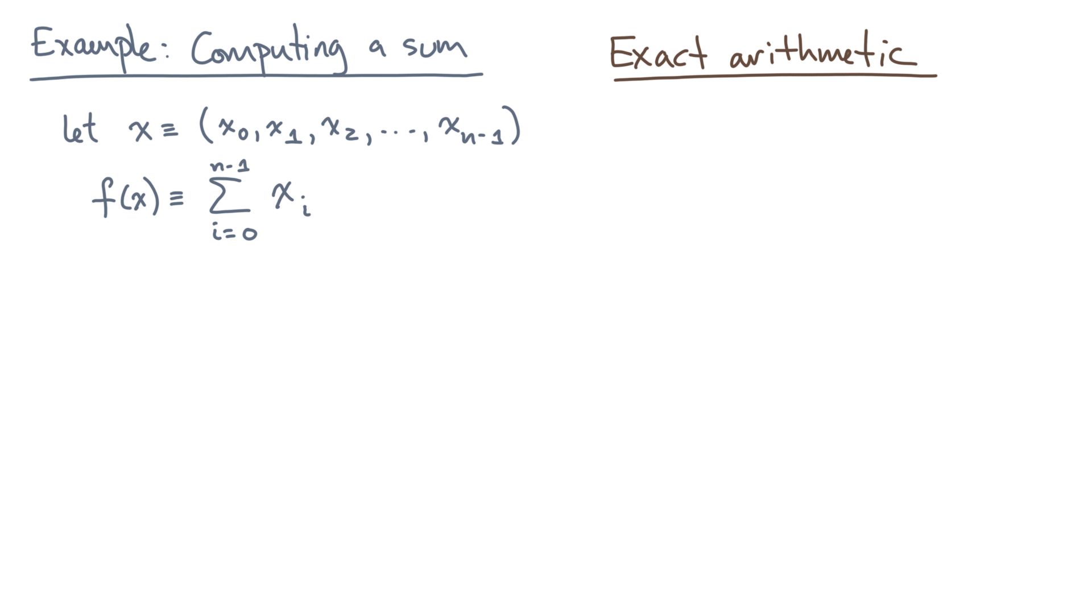
def alg_sum(x):
s = 0.0
for x_i in x:
s += x_i
return s
Notes:
Let’s start by *ignoring* floating-point.
That is, let’s do an analysis in “exact arithmetic,” assuming no rounding errors.

Slide 13
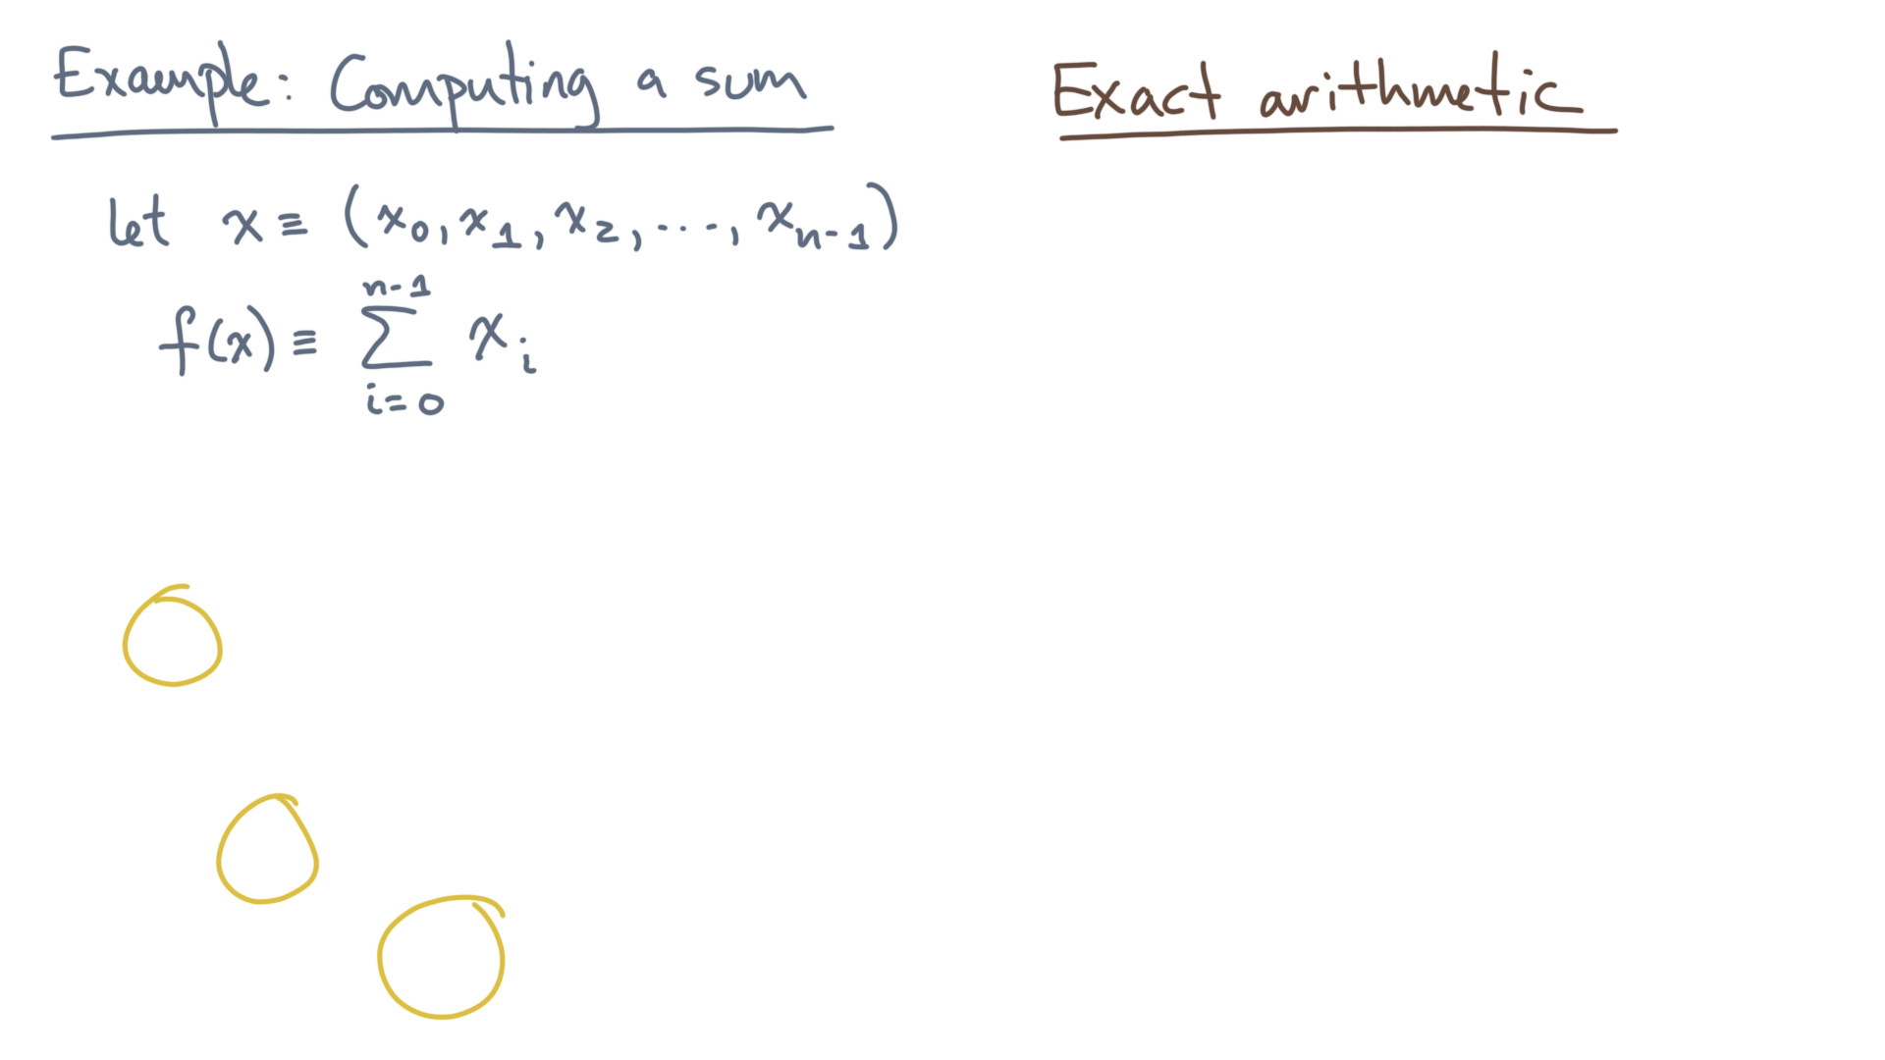
def alg_sum(x):
s = 0.0
for x_i in x:
s += x_i
return s
Notes:
Consider this temporary variable, “s”, which is the object that keeps changing and eventually holds the output.

Slide 14
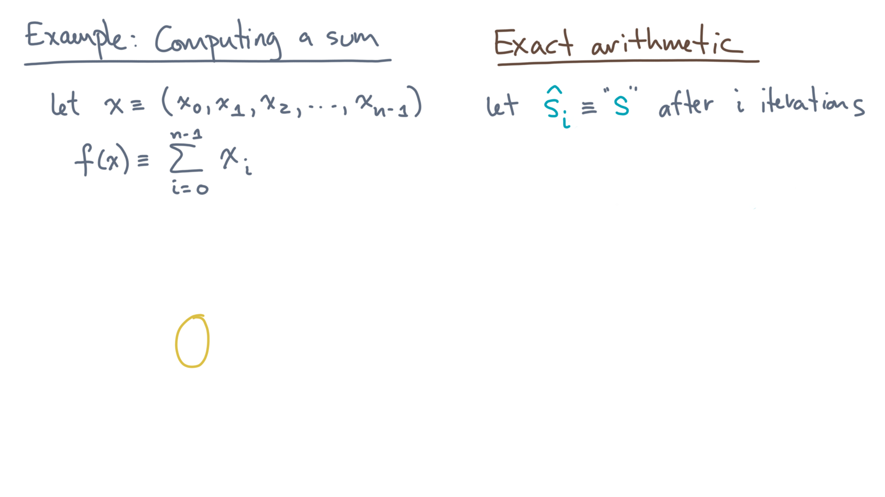
def alg_sum(x):
s = 0.0
for x_i in x:
s += x_i
return s
Notes:
Let’s start with an assumption about this loop.

Slide 15
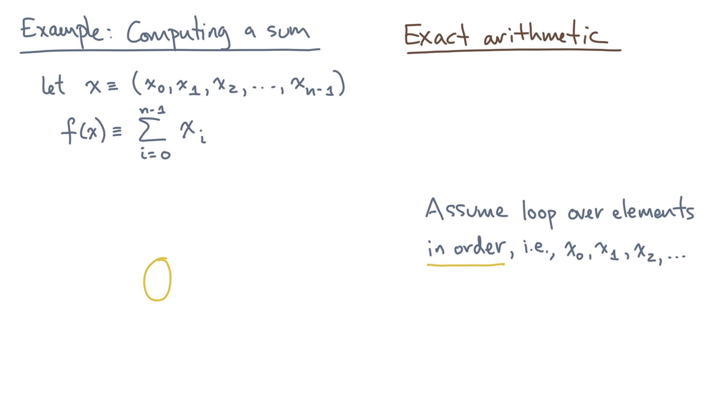
def alg_sum(x):
s = 0.0
for x_i in x:
s += x_i
return s
Notes:
In particular, suppose it produces the elements of “x” in order, meaning x_0 first, then x_1, then x_2, and so on.

Slide 16
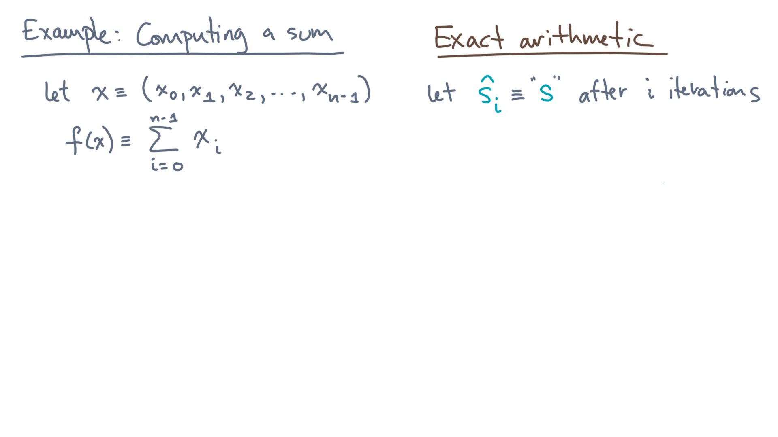
def alg_sum(x):
s = 0.0
for x_i in x:
s += x_i
return s
Notes:
Next, let s-hat-sub-i denote the value of the variable “s” at the end of each loop iteration.

Slide 17
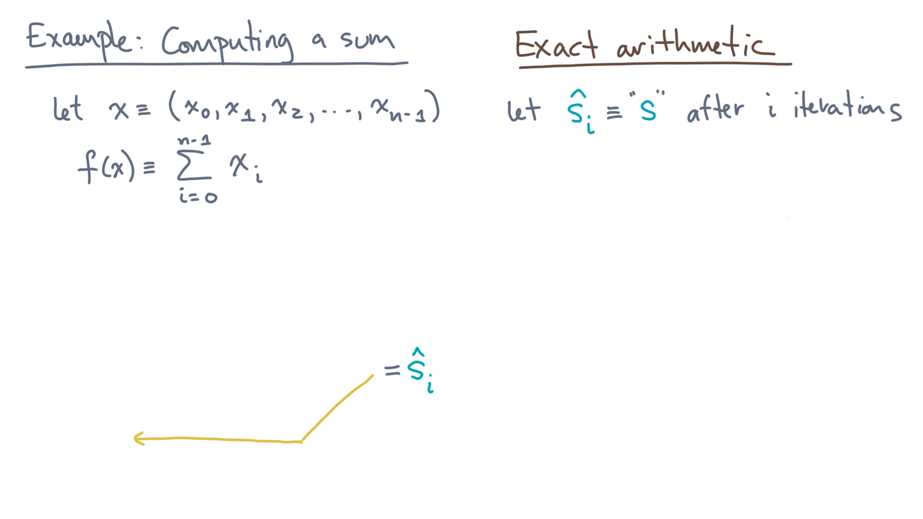
def alg_sum(x):
s = 0.0
for x_i in x:
s += x_i
return s
Notes:
That is, s-hat-sub-i is the value of “s” immediately after the update to “s” occurs inside the for-loop.
For example, s_hat sub 0 will be the result of the first addition.

Slide 18
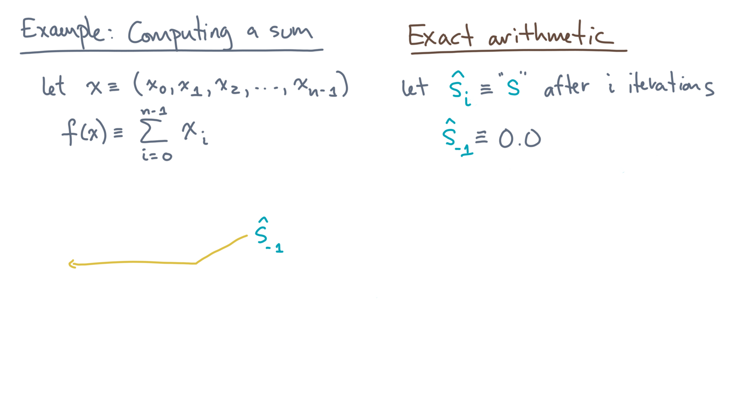
def alg_sum(x):
s = 0.0
for x_i in x:
s += x_i
return s
Notes:
From this notation, it would also be natural to define s-hat-sub-negative-one to be the initial value of “s”, which is 0.

Slide 19
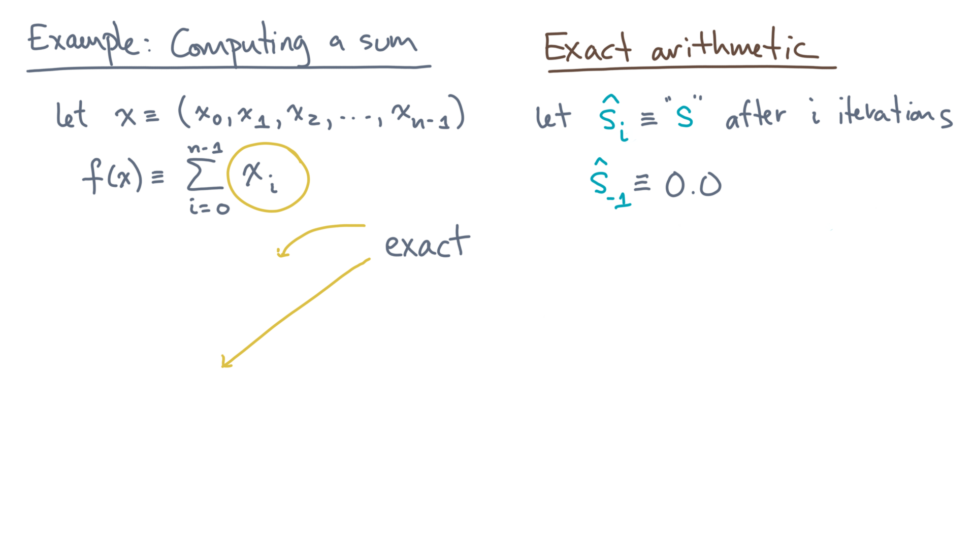
def alg_sum(x):
s = 0.0
for x_i in x:
s += x_i
return s
Notes:
Lastly, to understand the result of this function, let’s assume that the input values are *exactly* the same as the collection of x-i values in the problem statement.
If instead the input has errors or some kind, you’ll need to propagate that error to the result somehow.
But let’s worry about that later.

Slide 20
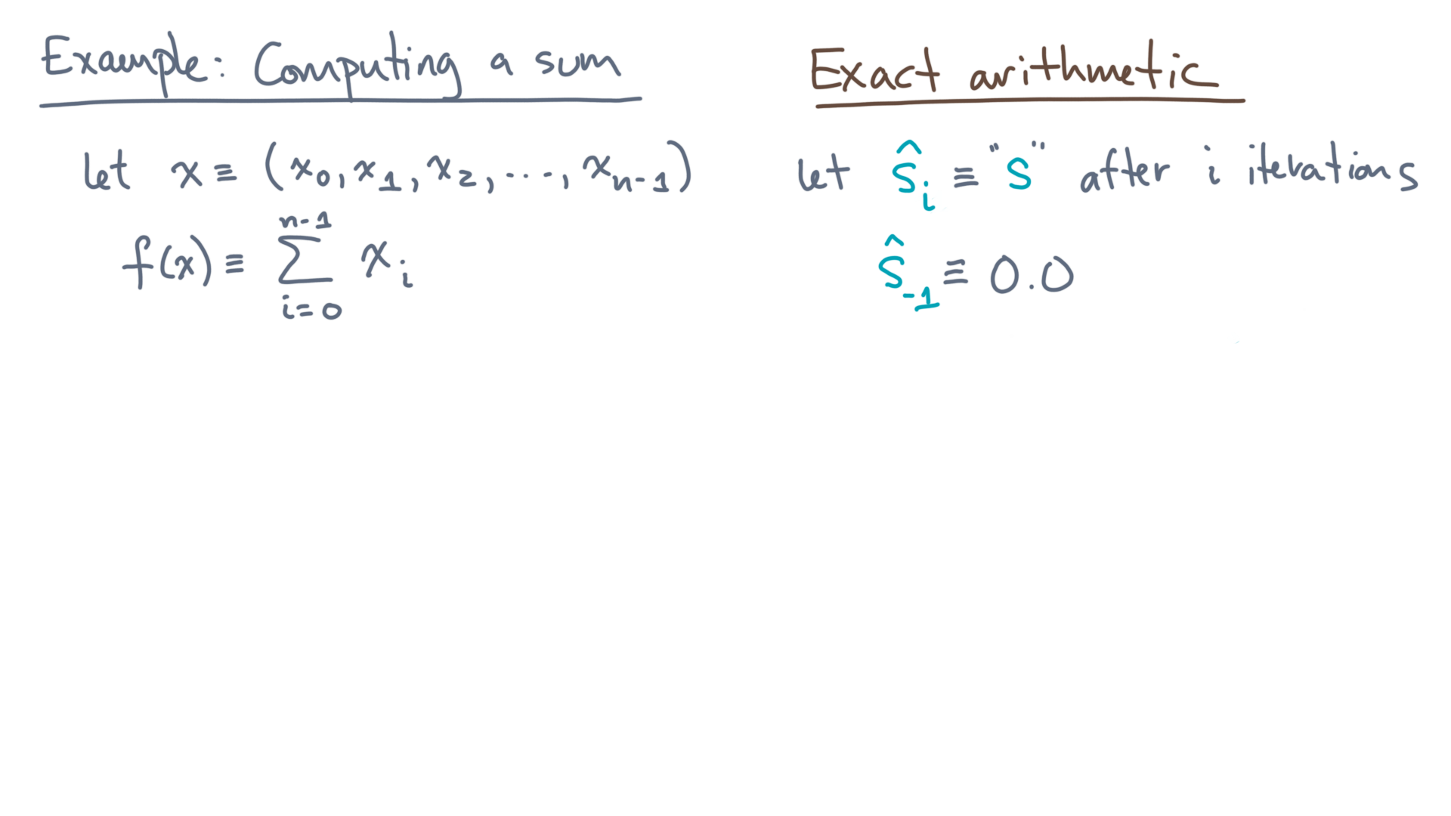
def alg_sum(x):
s = 0.0
for x_i in x:
s += x_i
return s
Notes:
So here’s what you want to know.

Slide 21
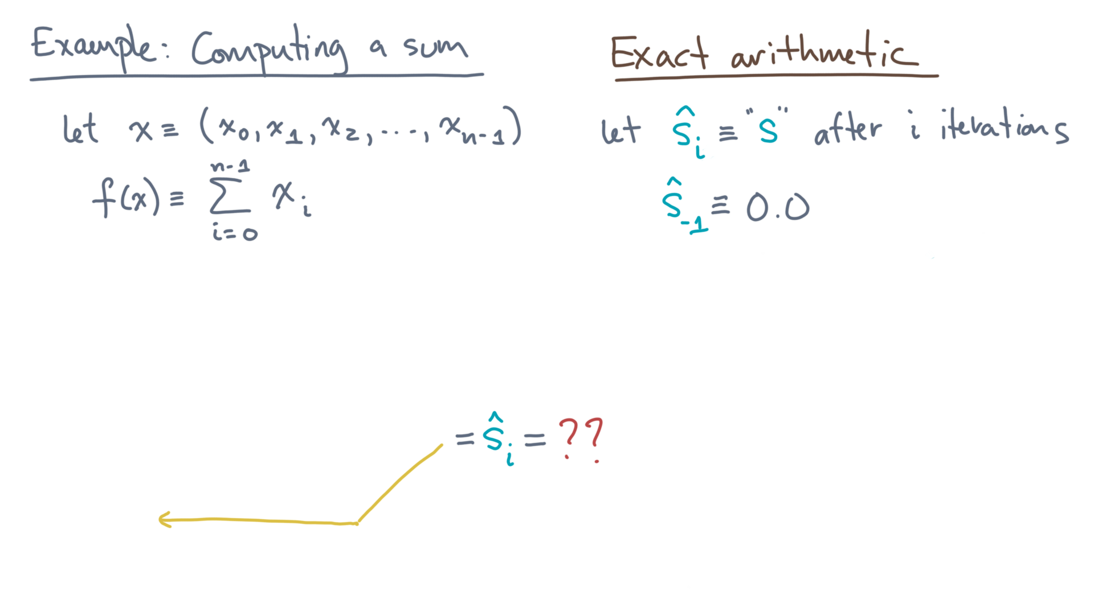
def alg_sum(x):
s = 0.0
for x_i in x:
s += x_i
return s
Notes:
Returning to the end of the loop body, what is the value of s-hat-sub-i?

Slide 22
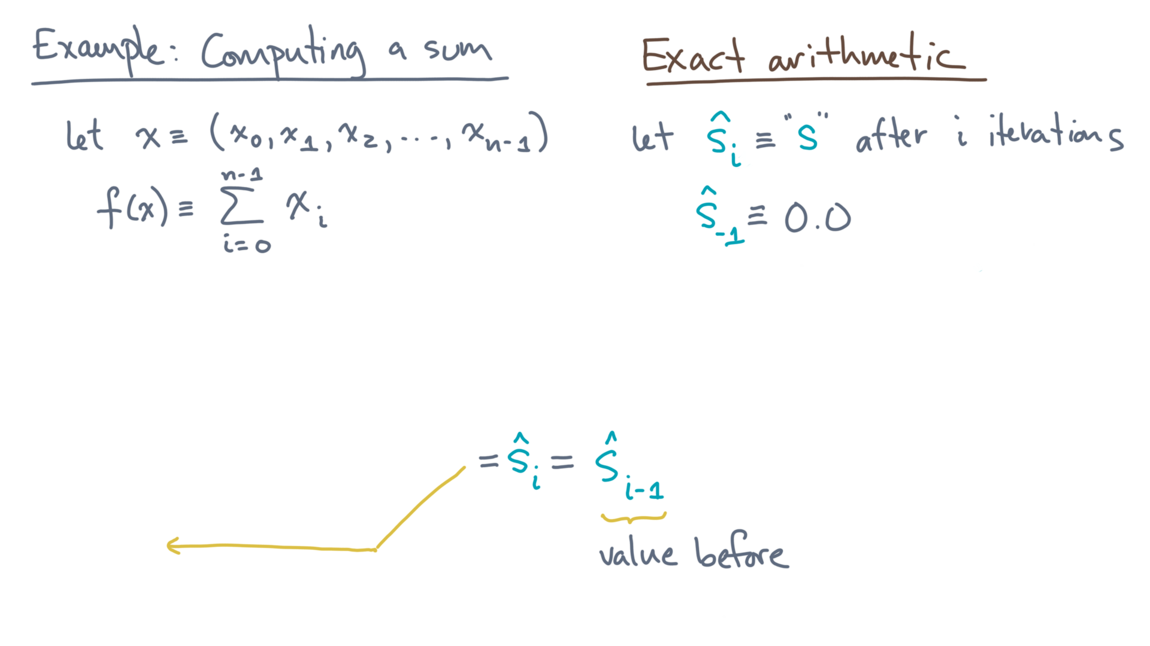
def alg_sum(x):
s = 0.0
for x_i in x:
s += x_i
return s
Notes:
It starts with the value just before the update, s-hat-sub-i-minus-one.

Slide 23
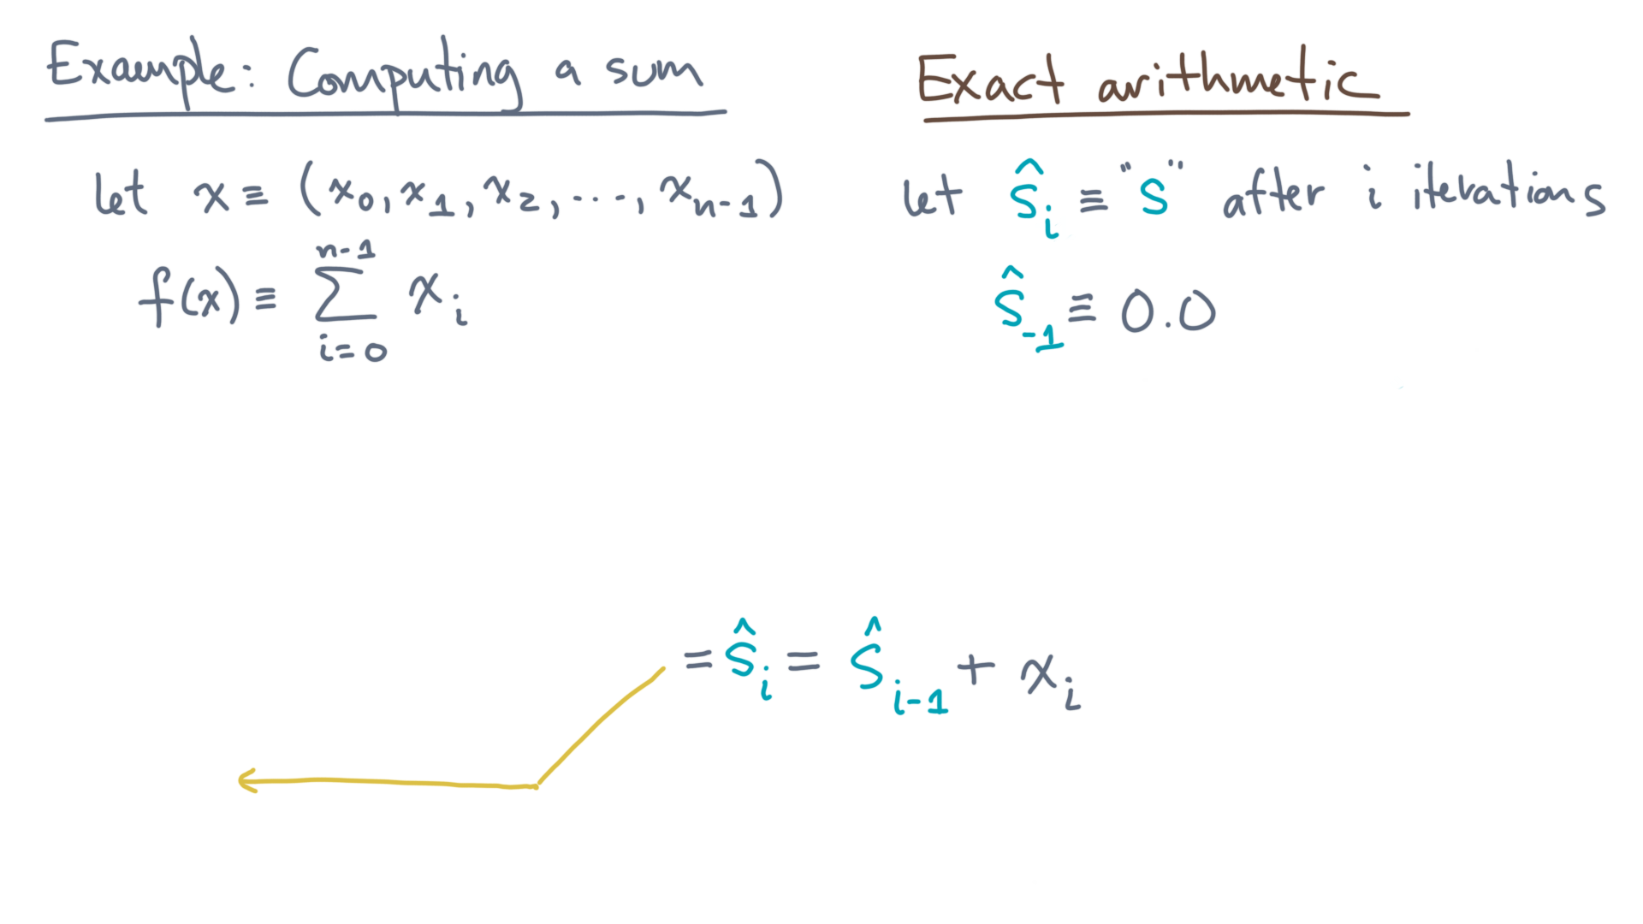
def alg_sum(x):
s = 0.0
for x_i in x:
s += x_i
return s
Notes:
Then it accumulates the next value from the collection, x-sub-i.
You can ask again: what is s-hat-sub-i-minus-one?

Slide 24

def alg_sum(x):
s = 0.0
for x_i in x:
s += x_i
return s
Notes:
It’s a similar thing: it’s the previous value, s-hat-sub-i-minus-two, plus x-i-minus-one.

Slide 25
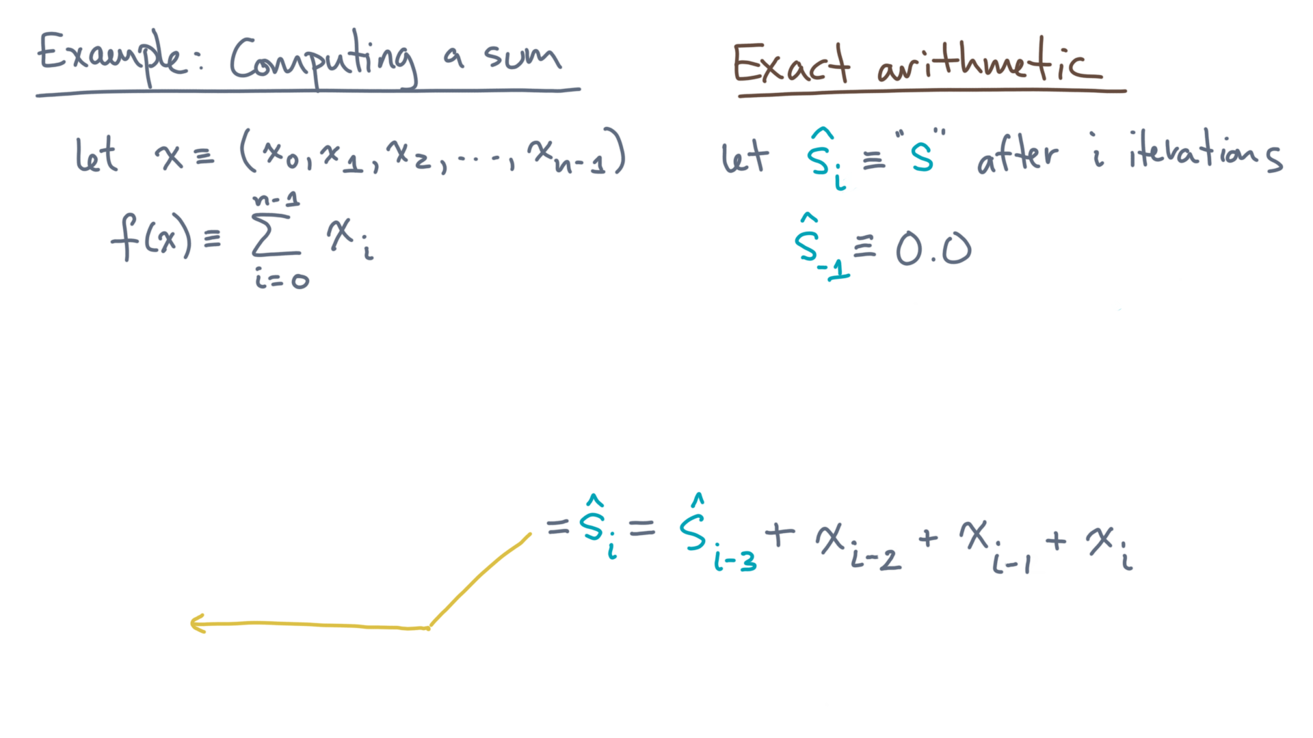
def alg_sum(x):
s = 0.0
for x_i in x:
s += x_i
return s
Notes:
And you can keep going like this, expanding the recurrence.

Slide 26
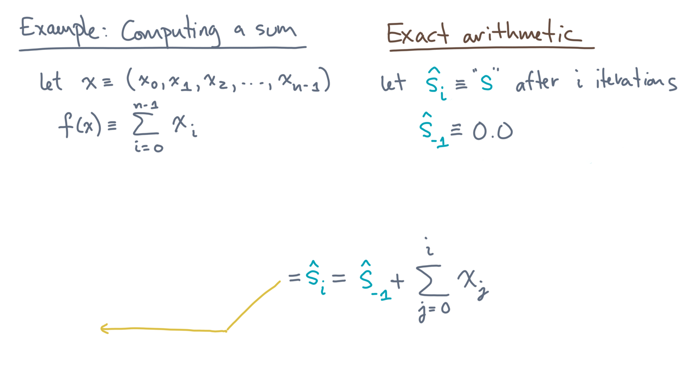
def alg_sum(x):
s = 0.0
for x_i in x:
s += x_i
return s
Notes:
Going all the way to the beginning, you’ll end at s-hat-minus-one.

Slide 27
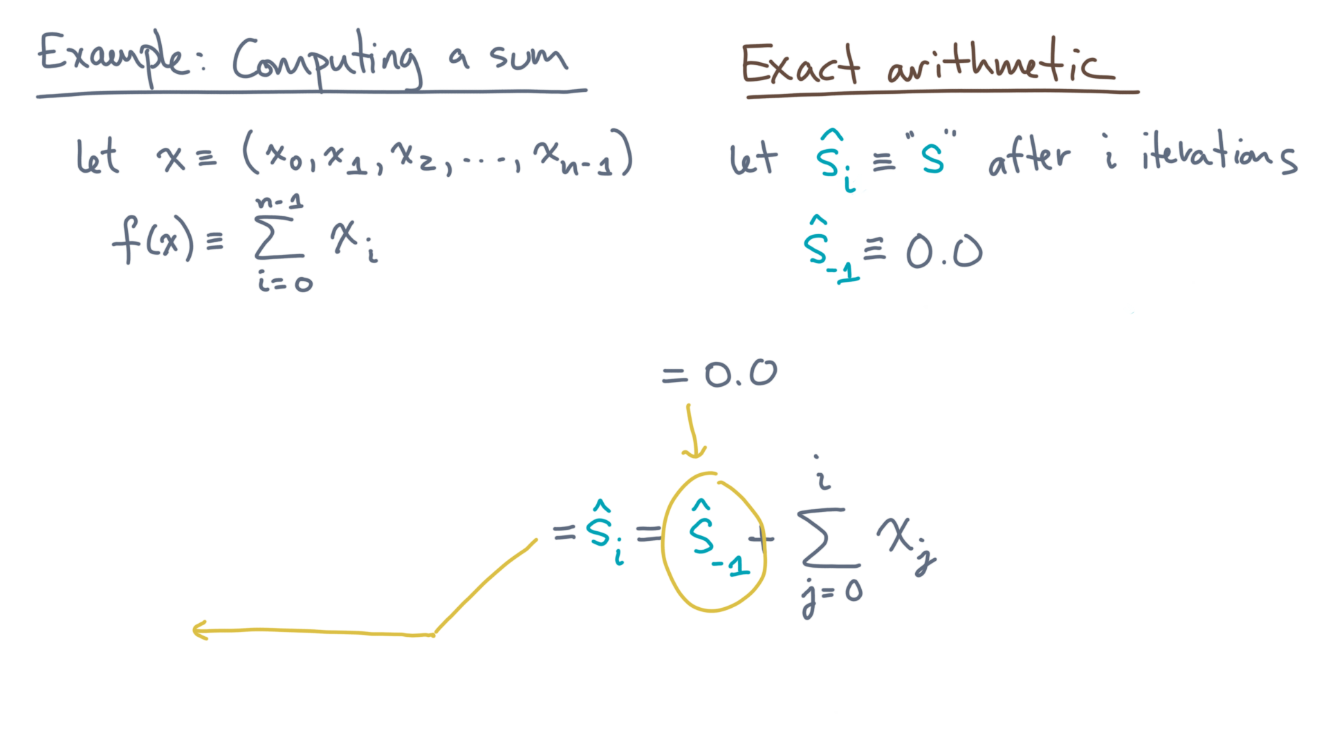
def alg_sum(x):
s = 0.0
for x_i in x:
s += x_i
return s
Notes:
And that value is just zero, since it’s the initial value before the loop begins.

Slide 28
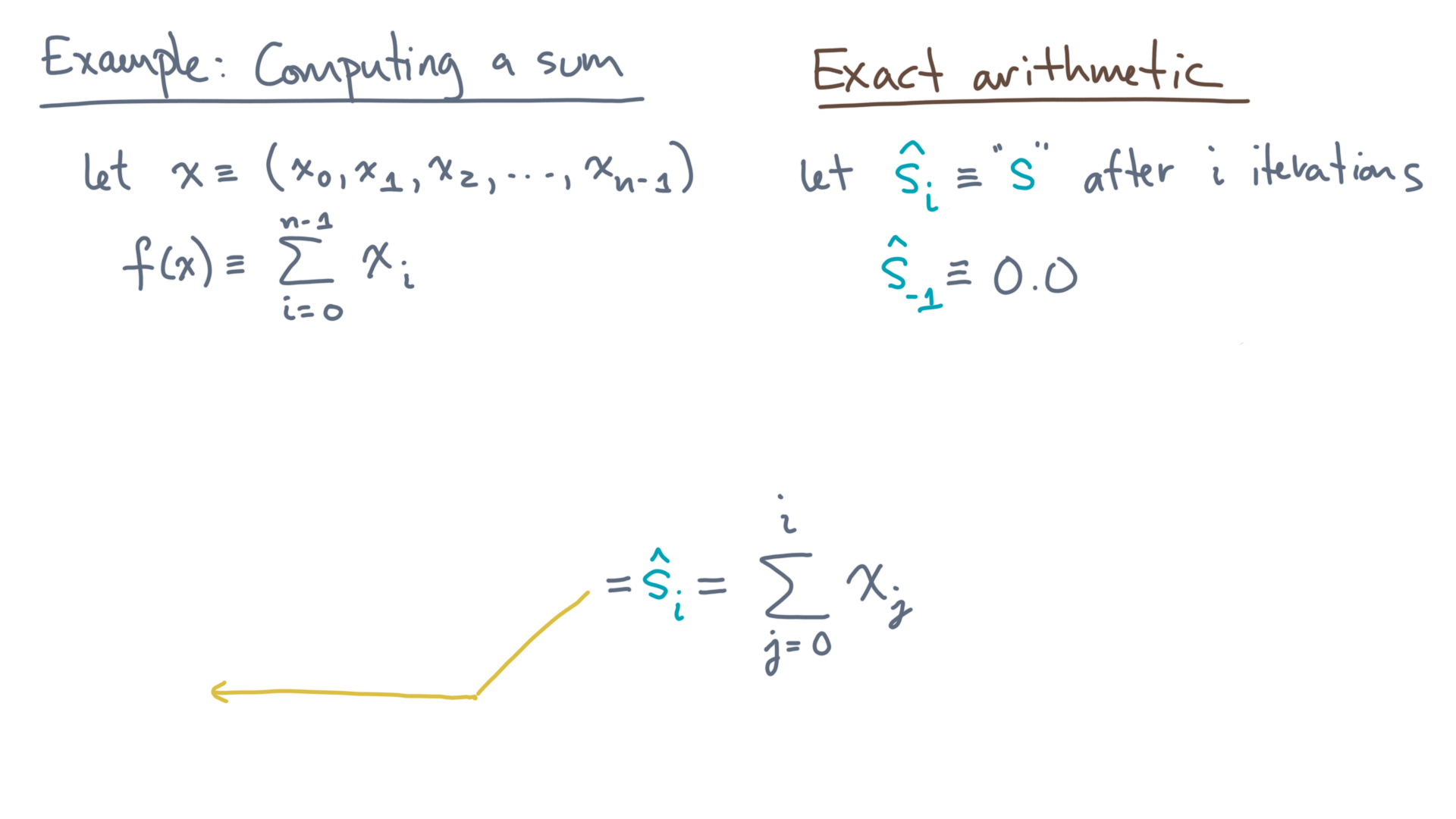
def alg_sum(x):
s = 0.0
for x_i in x:
s += x_i
return s
Notes:
Thus, s-hat-sub-i is just the partial sum of all the elements up to x-i.

Slide 29
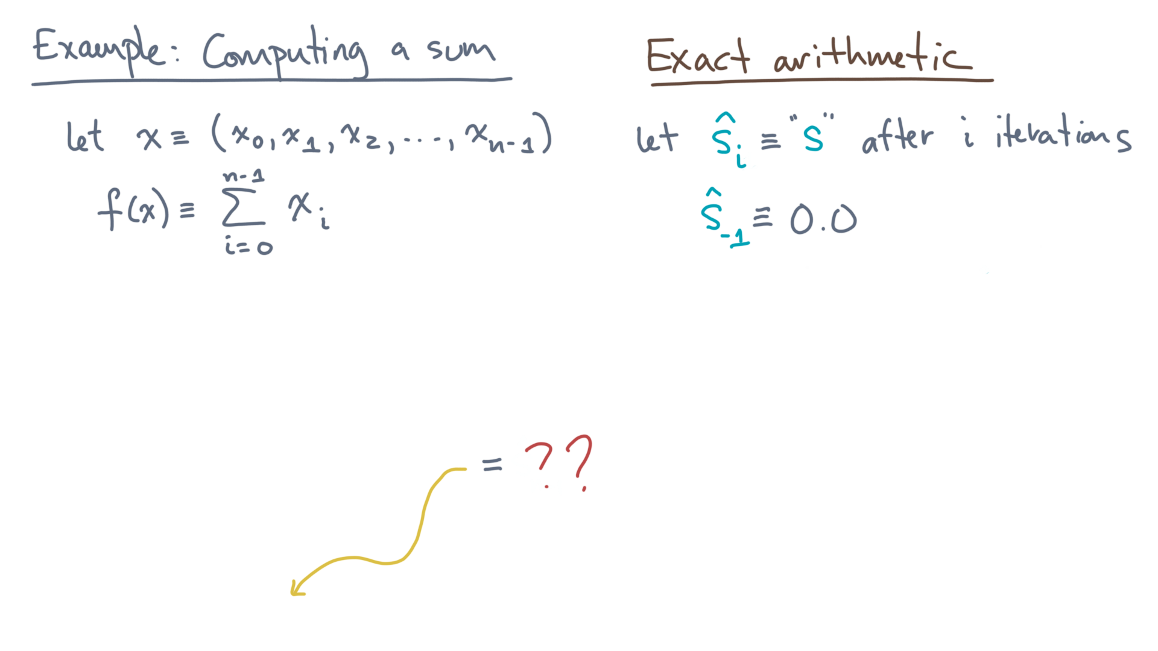
def alg_sum(x):
s = 0.0
for x_i in x:
s += x_i
return s
Notes:
That’s all well and good, but the value you want is the return value.

Slide 30
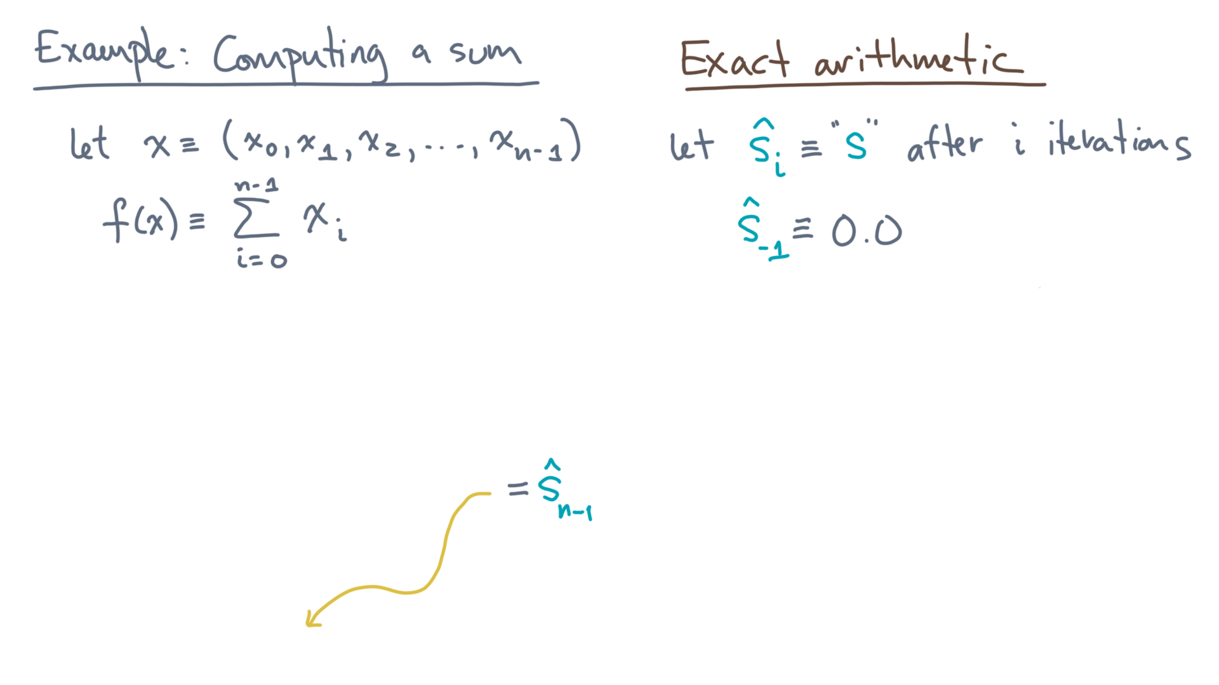
def alg_sum(x):
s = 0.0
for x_i in x:
s += x_i
return s
Notes:
But that’s just s-hat-sub-n-minus-one!

Slide 31
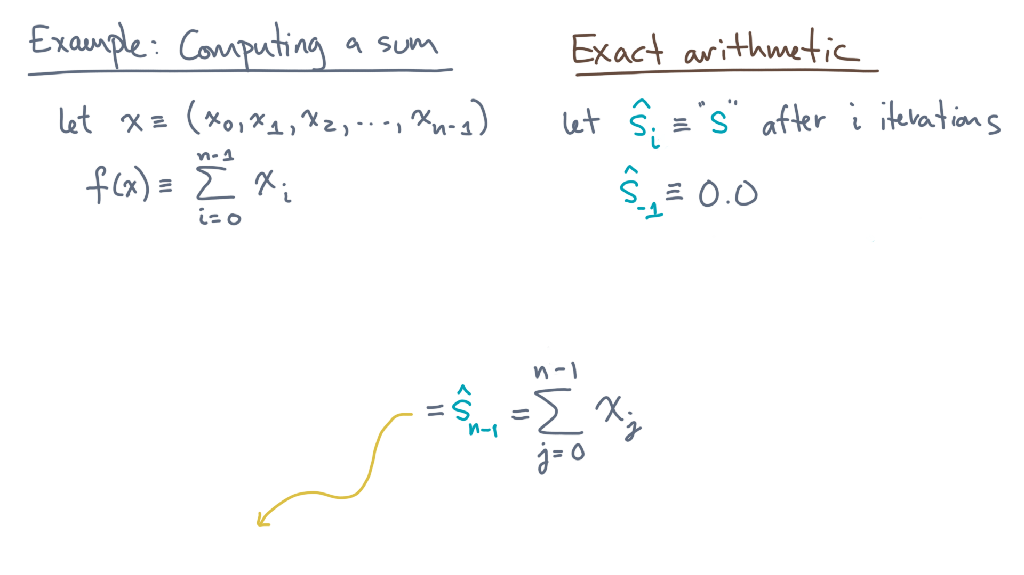
def alg_sum(x):
s = 0.0
for x_i in x:
s += x_i
return s
Notes:
So that must be the sum through x-n-minus-one.

Slide 32
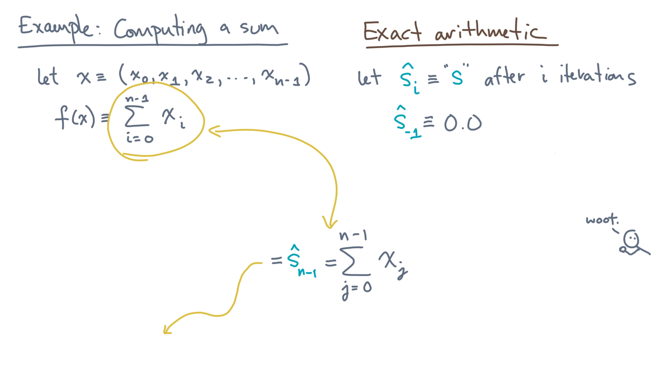
def alg_sum(x):
s = 0.0
for x_i in x:
s += x_i
return s
Notes:
Which, of course, is exactly what we wanted in the first place!

Slide 33
Notes:
Of course, this analysis assumes *exact* arithmetic.
But the whole point of this module is that finite-precision means there will be rounding errors.
So now is a good time for you to pause to review what you just did, before we discuss how to reason about correctness in the presence of rounding errors.

